Slide 1

Optimizing Efficiency: The Role of Cage Wheel Lifters in Modern Industry

Slide 2

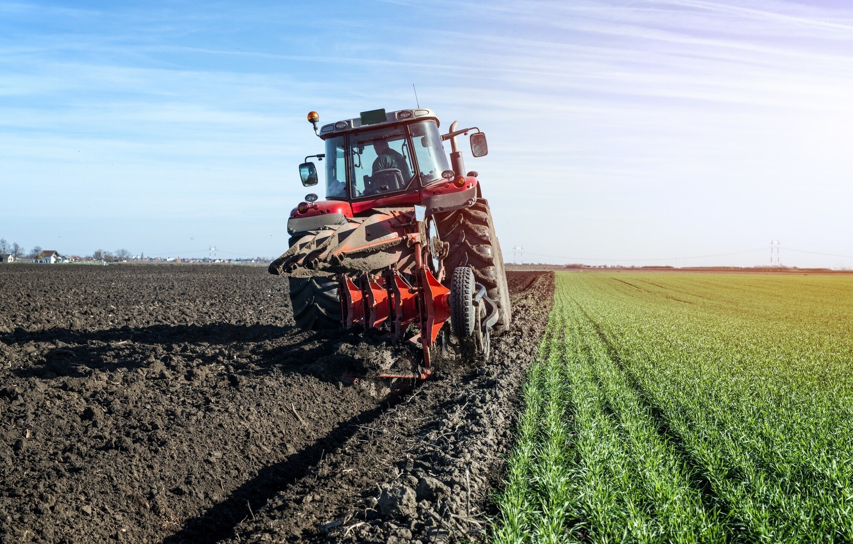
Introduction to Cage Wheel Lifters
In modern agriculture,cage wheel liftersplay a crucial role in enhancingefficiency. This devices is used to fix the cage wheel in tractor and gauge wheel help to change rough soil into mud and optimizeplanting depthand improve seed placement, ensuring uniform crop growth. This presentation explores their significance and impact on agricultural practices.

Slide 3
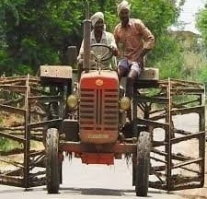
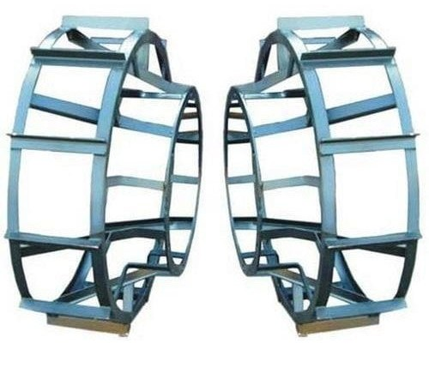


Understanding Cage Wheel Lifters
Cage wheel lifters are mechanical devices designed to elevate and transport loads safely. Their construction allows for stability and precision, making them essential in sectors like manufacturing and logistics, where handling heavy materials is routine.

Slide 4
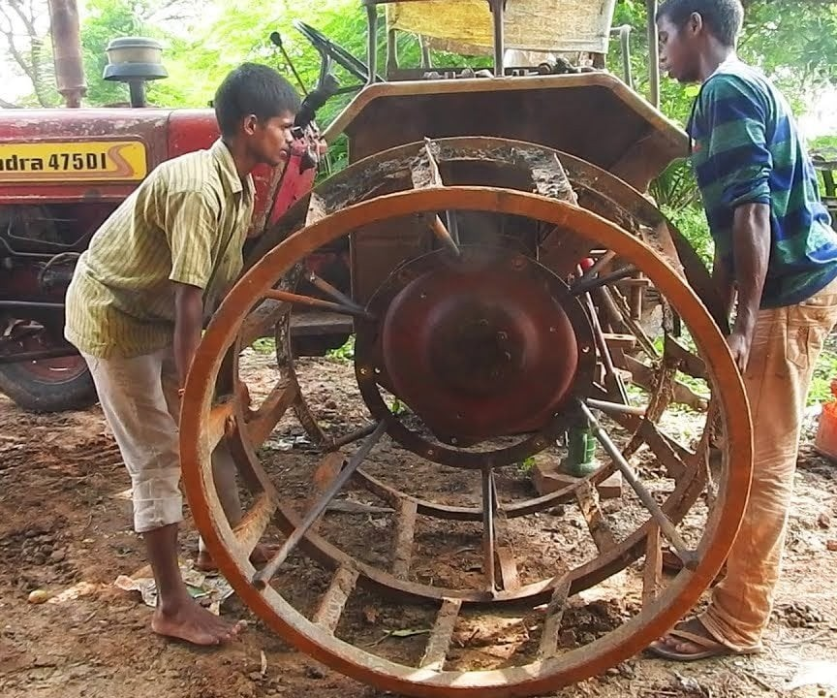
TRADITIONAL METHOD FIXING CAGE WHEEL
The cage wheel is around 300kg which is very tough to fix the cage wheel in tractor
,it requires approximately 3 people lift and fix the cage wheel .for this we found a alternative method "cage wheel lifter"

Slide 5
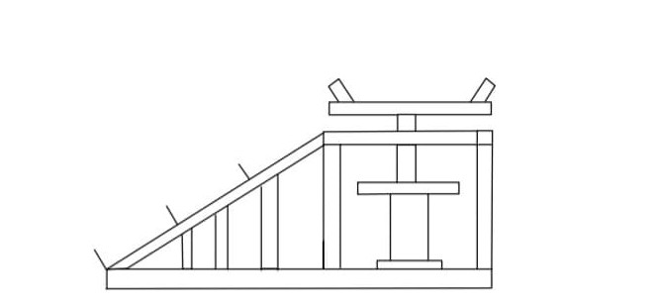
Model Diagram

Slide 6
Cost Estimation
500₹
200₹
150₹
1200₹
2100₹
square rod normal rod metal sheet Jack
TOTAL

Slide 7
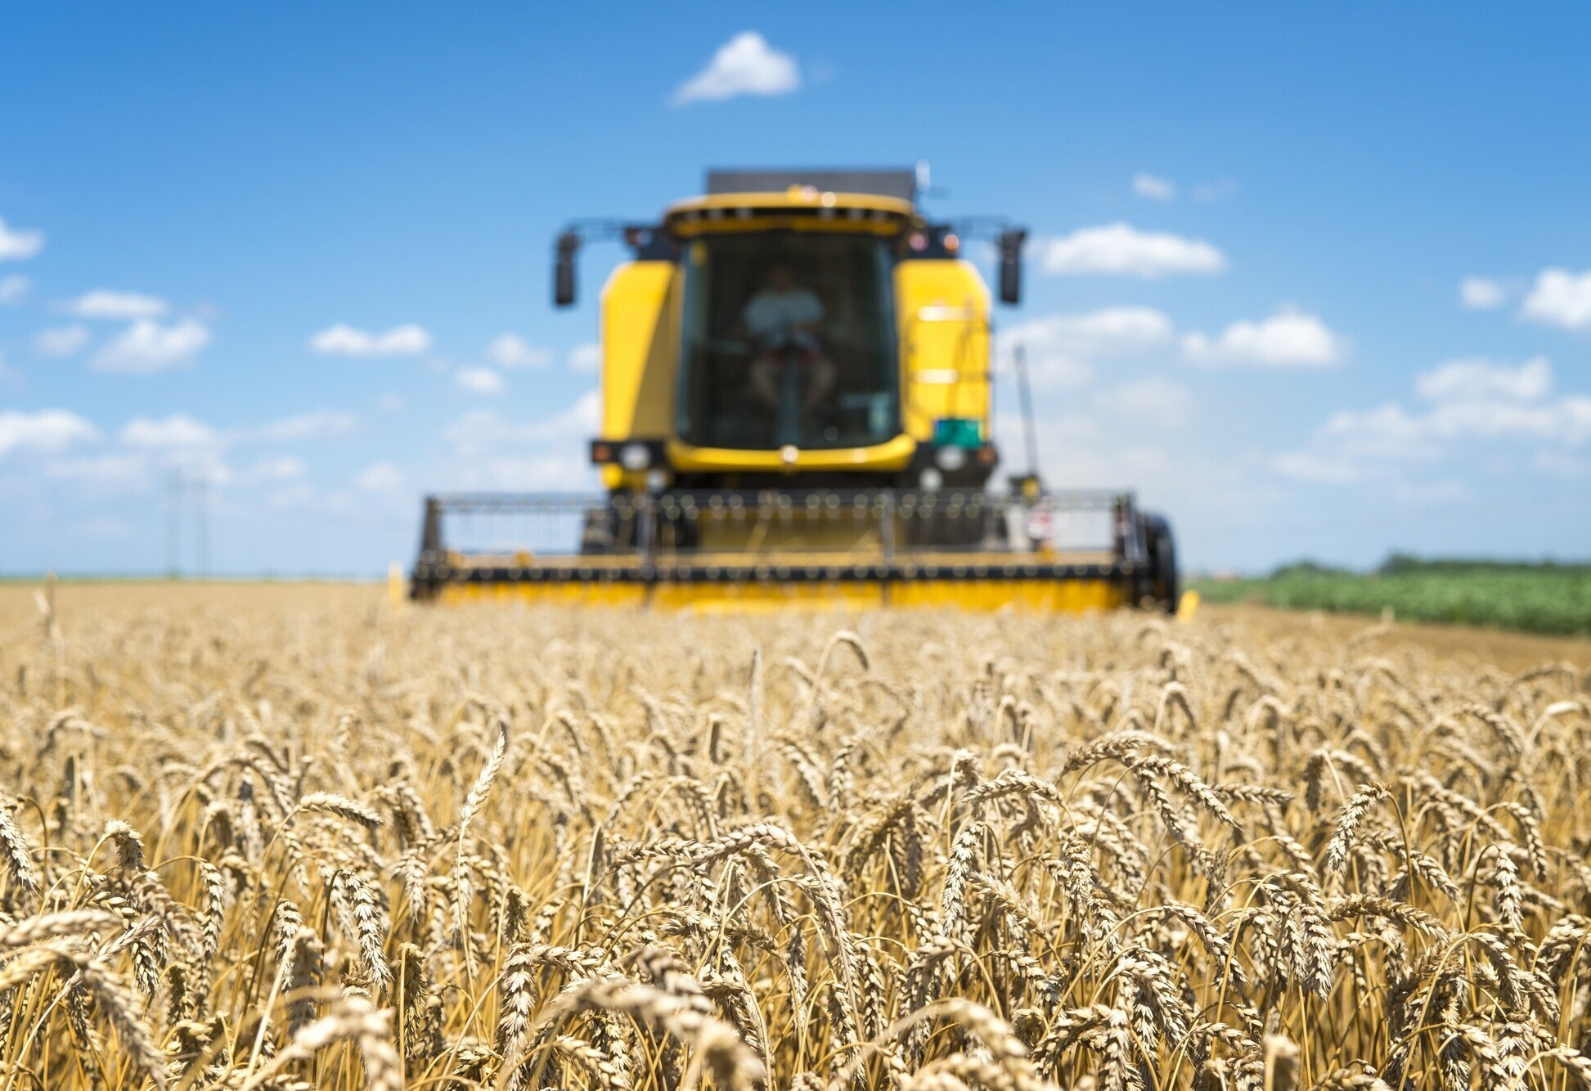
construction
Place two square rod in measurement of 25 inches and side length of 15 inches .Place the square rod in the interval of 6 inches and fix two square in taper position 40 to 45 degree, form a cube in opposite side taper rods and weld rods. place jack inside cube.

Slide 8
working
Place the cage wheel lifter on one side of rear wheel , push the cage wheel to the taper side lifter next adjust the jack to required height fix wheel with nut and bold . Reduce the height of jack and take gauge wheel lifter do same process on the other side

Slide 9

Future Innovations
As technology advances, the design and functionality of cage wheel lifters continue to evolve. Innovations such as smart sensors and automation will further enhance their efficiency and adaptability in a rapidly changing industrial environment.

Slide 10


Slide 11


